Slide 1
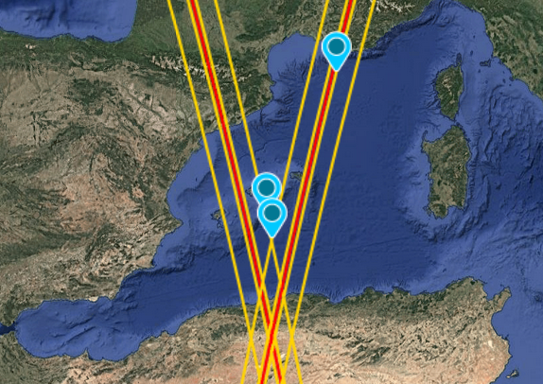
Observing Lagrangian transport pathways in the Mediterranean Sea from space
Candidate: Alessandro Storer

Slide 2

Academic formation and current activity
2019-2022 BSc. in Physics
University of Milan
Review of the comparison between state-of- the-art reanalysis ERA5 and observational data over normal values and long-term trends
2022-2024 MSc. in Environmental Meteorology
University of Trento and University of Innsbruck
Studying the mesoscale coupling between atmosphere and ocean in a high-resolution simulation: how are the marine boundary layer and heat fluxes impacted by the SST anomalies?
2025 – current Junior research assistant and tutoring in “Physics of the sea”
refine thesis results - one proceeding and one full article
Support teaching
Find a PhD

Slide 3






Slide 4
MSc. Thesis
A brief outline

Slide 5

Boundary Layer
T , q air
wind
SST, q source
Turbulent fluxes
LHF, SHF
currents
Notes:
the coupling between marine shallow
trade-wind clouds and circulation is known to play a cen-
tral role in the uncertainty of the tropical cloud feedback and climate sensitivity estimated by models

Slide 6
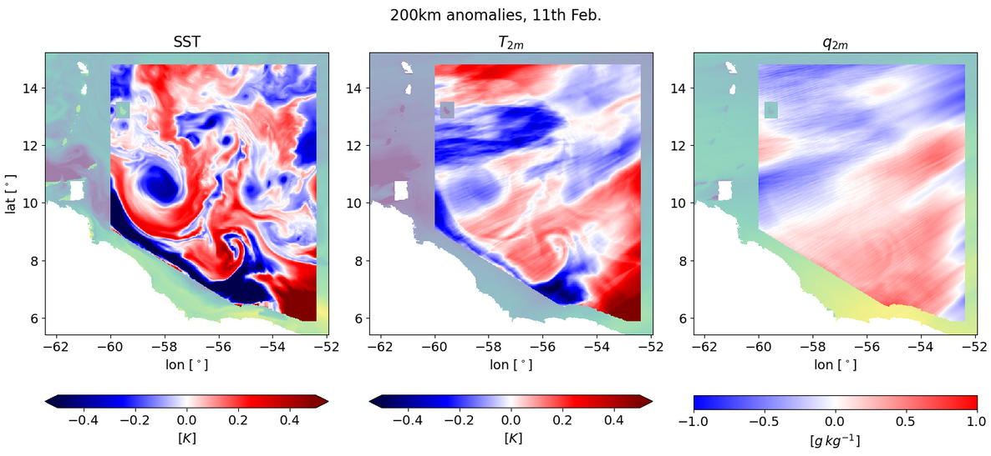
Fully coupled 3D simulation
High-pass filtered fields (200 km) – 11th Feb. 2020

Slide 7
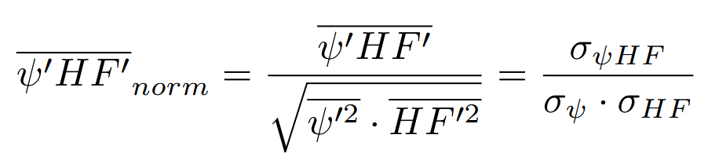
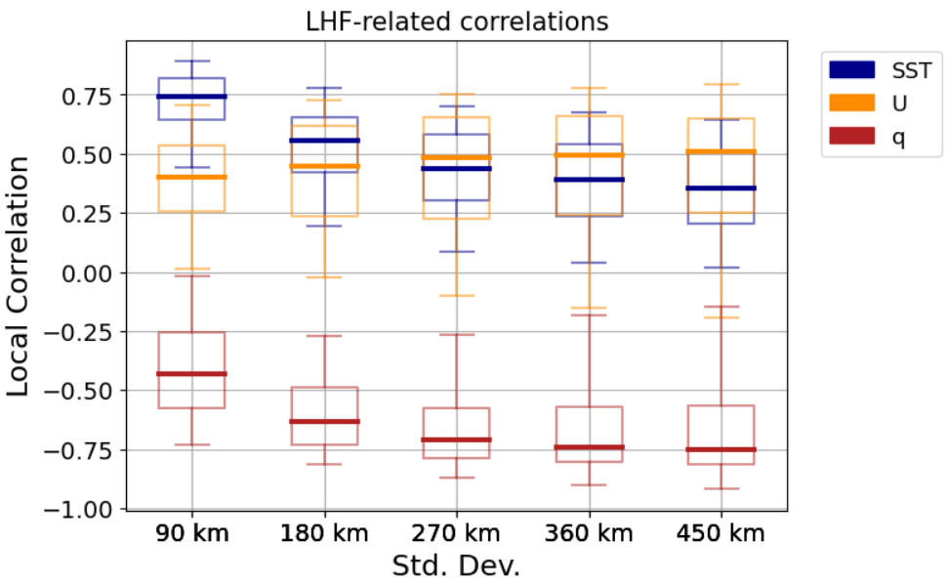
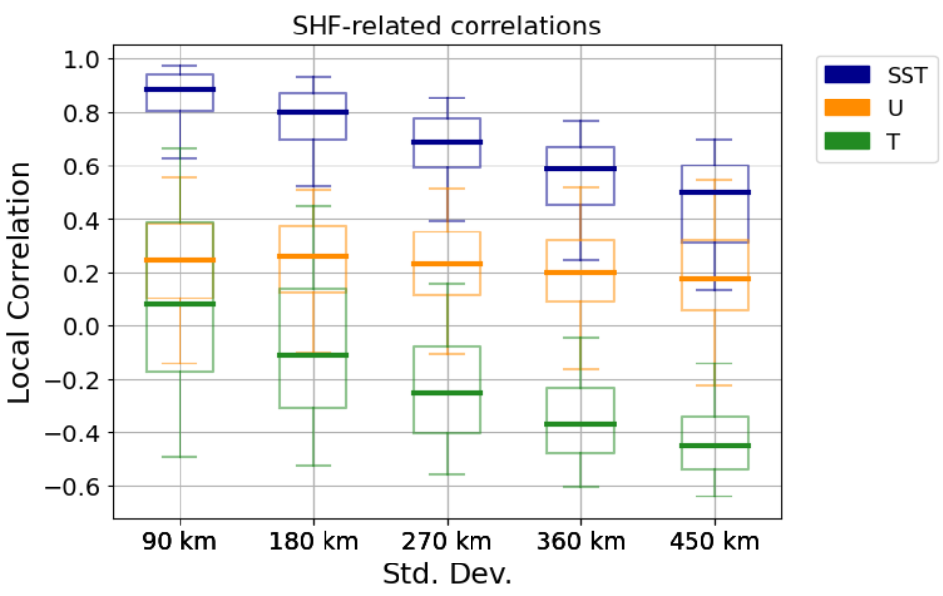
What’s driving heat fluxes?

Slide 8
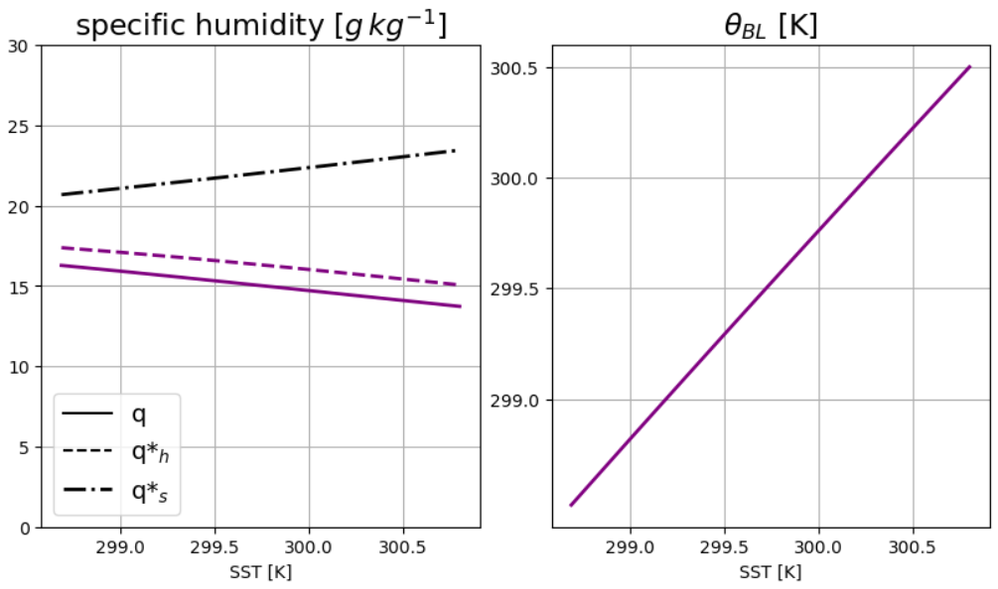
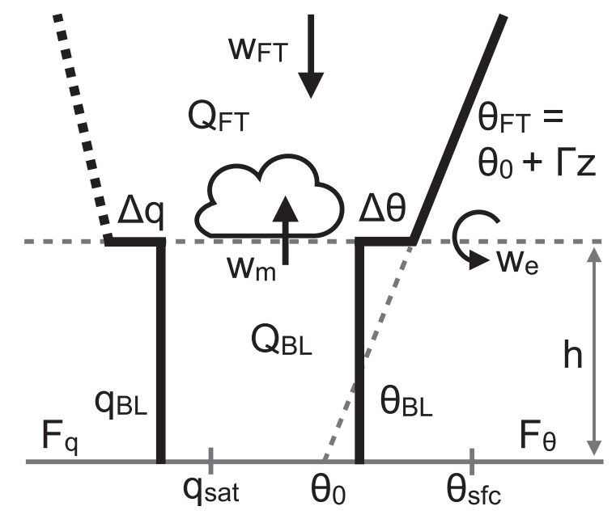

Bulk Model
Conceptual Bulk model
starring:
Stevens et al. 2002
Neggers et al. 2006
Naumann et al. 2019
Moisture decreases!
Temperature follows SST
!?

Slide 9
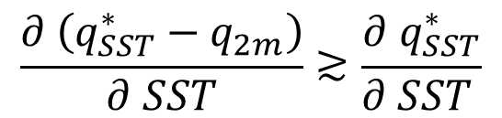
Graphical summary
Lively thermo - / dynamics
at the mesoscale!
MABL’
MABL moisture set by
SURFACE EVAPORATION
ENTRAINED DOWNWELLING
Feedback on surface LHF
$$\frac{∂ \left(q_{SST}^{∗}−q_{2m}\right)}{∂ SST}≳\frac{∂{ q}_{SST}^{∗}}{∂ SST }$$
SST’ < 0
SST’ > 0

Slide 10
Now – why a PhD ?
Great passion for what I am doing
Feeling part of a community
Met like-minded people who provided good examples
Social impact of my activity - communication
What I am looking for / looking forward to meeting
Supporting and communicating team – I like exchanging ideas
Strengthen my critical reasoning
Hope to focus more on the quality of my thesis rather than the quantitative production for my future carreer

Slide 11
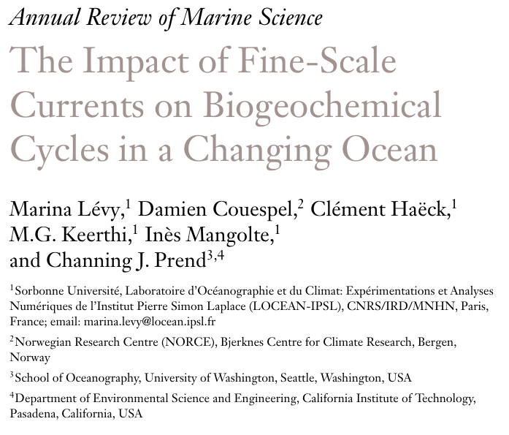
Article discussion
Provides broader-view motivations and open questions, rather than delving straight to the methodology
Focuses on the physical processes

Slide 12
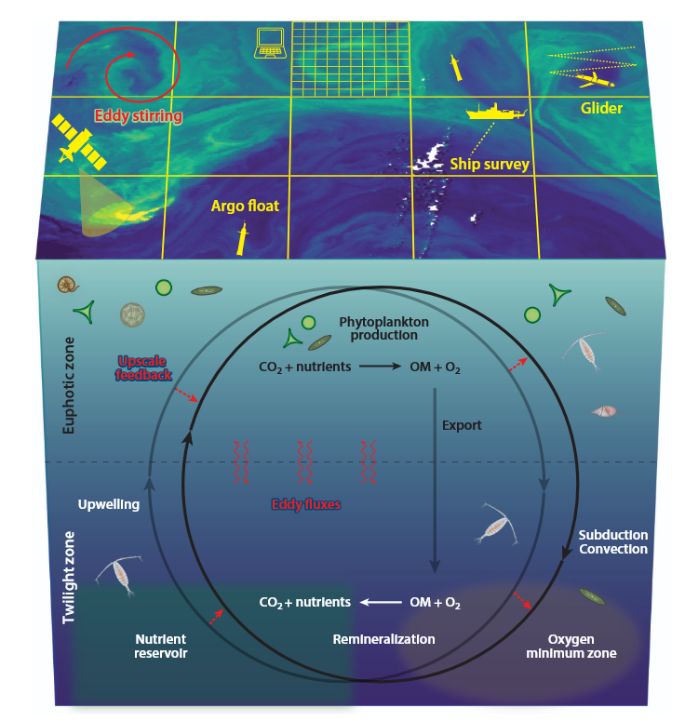
Context
Main subject
Influence of fine-scale oceanic processes
on marine biogeochemical cycles: current
knowledge and prospects on future changes
OBSERVATIONAL EVIDENCES:
surface nutrient budget is NOT closed
Large-scale exchanges only cannot explain discrepancies
What is the role of fast, unresolved dynamics?
Notes:
how to close the surface nutrient budget in order to sustain the observed level of oceanic primary production: can it be explained by enhanced vertical mixing?
photosynthetic fixation of carbon by phytoplankton at the surface
Patterns in sea surface phytoplankton clearly reflect the influence of stirring -- “DRIFTING FORESTS”
Horizontal diffusion is a passive stirring mechanism, since it drives a spatial rearrangement of the tracer; whereas vertical turbulent mixing (eddy advection) acts on the local quantity of the tracer itself
Sub-surface isopycnal diffusion; high-resolution coupled physical–biogeochemical models have shown primary production to increase by up to a factor of 3 when submesoscale features are resolved

Slide 13
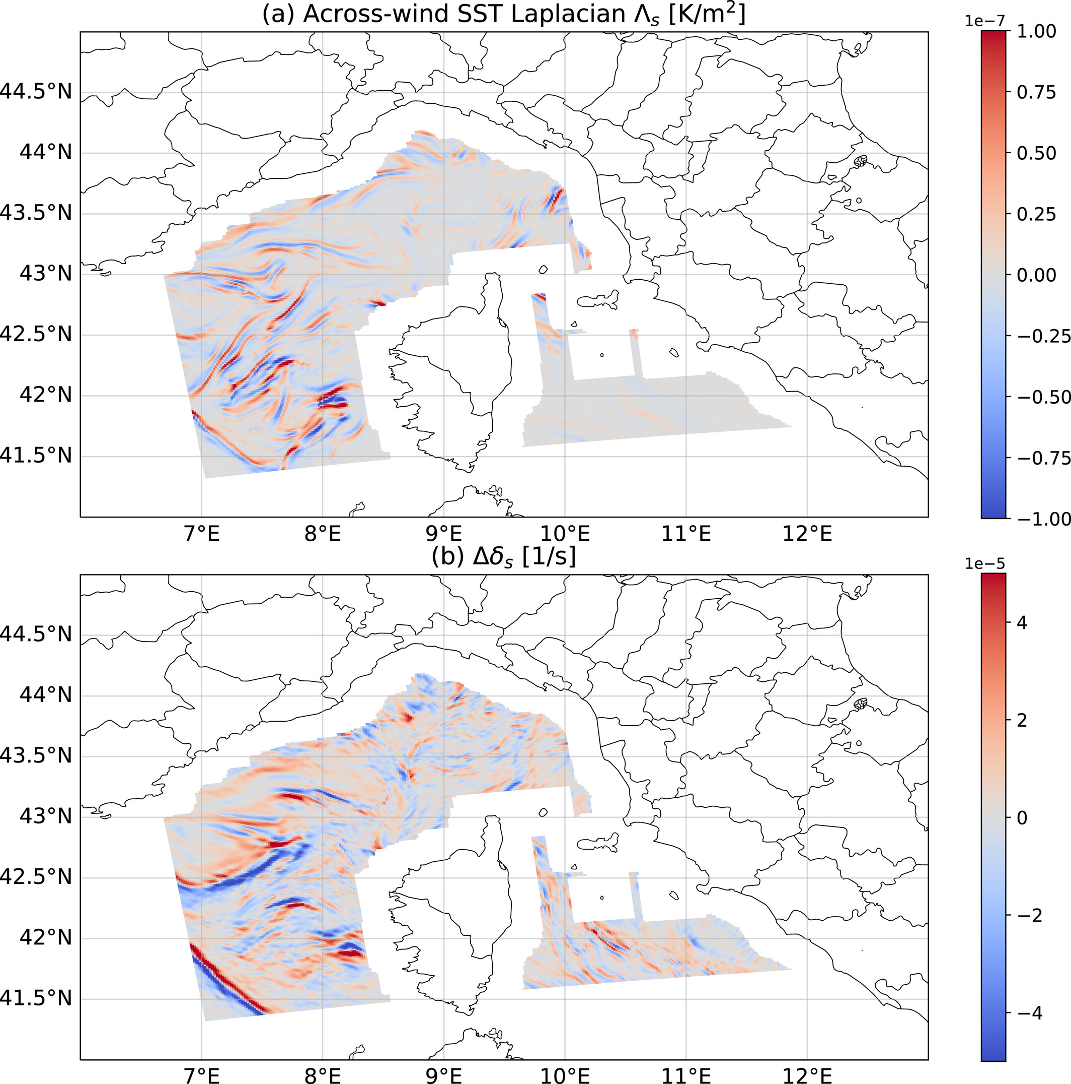
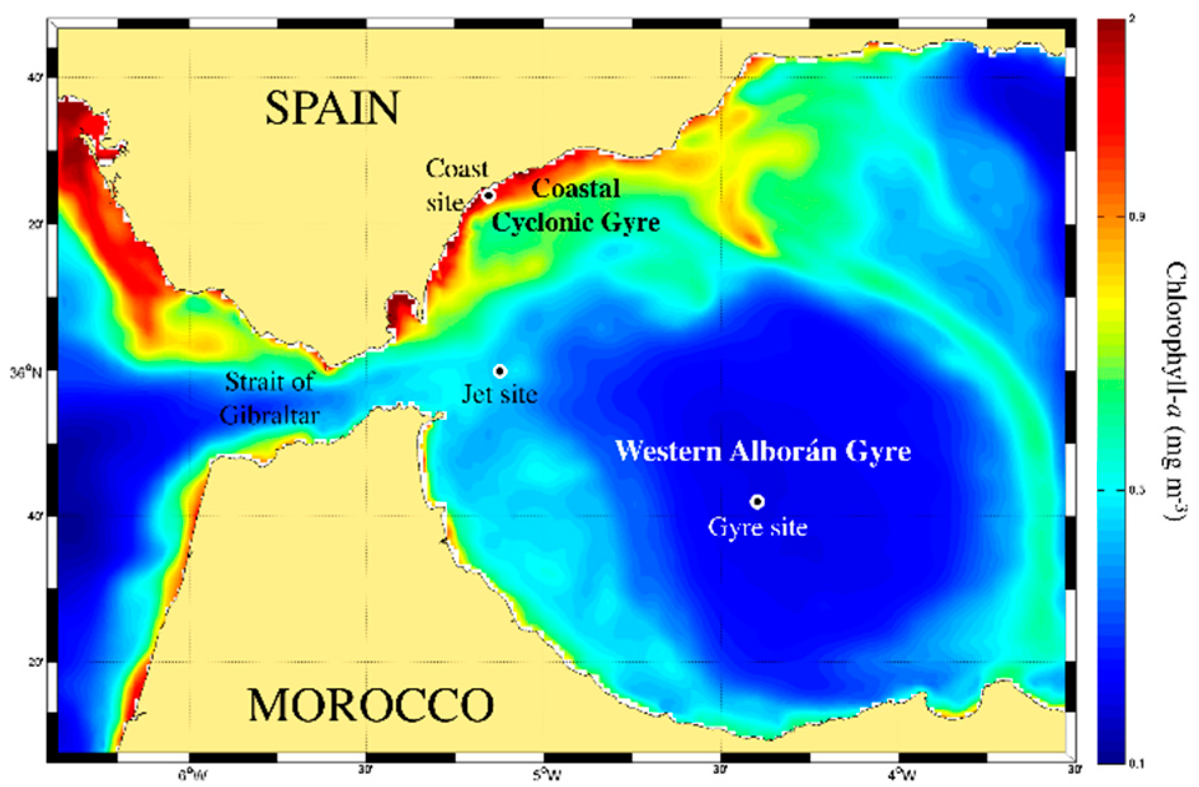
The submesoscale
Bartual et al, 2020
Meroni et al, 2022
Notes:
include unbalanced wave motions, such as near inertia waves and internal gravity waves, and balanced non-wave motions, such as the ageostrophic submesoscale vortices and filaments emerging from frontogenetic instability
Waves are too fast
Instead, the balanced submesoscale frontal processes involve the release of the potential energy of mesoscale fronts around eddies and can sustain vertical secondary circulation with time-scales comparable with the nutrient uptake by phytoplankton
Bartual et al, 2020 : https://www.mdpi.com/1660-3397/18/3/159

Slide 14
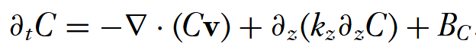
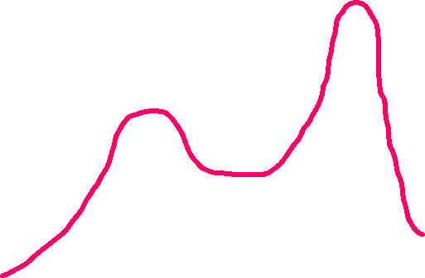
Impact pathways
Effects on local eddy fluxes:
- Horizontal stirring
Vertical mixing
Fully-3D problem
Energy
Upscale (feedbacks)
Downscale
Horizontal stirring
@ submesoscale, enhanced:
vertical advection
Twilight – euphotic mixing
Strongest vertical velocities ~ 10-100 m/day
Meso-submeso
Large scale
Notes:
Stirring acts more on the spatial re-organization of nutrients
Vertical mixing acts more on their actual quantity
Upscale feedbacks need long enough integrations to come about

Slide 15
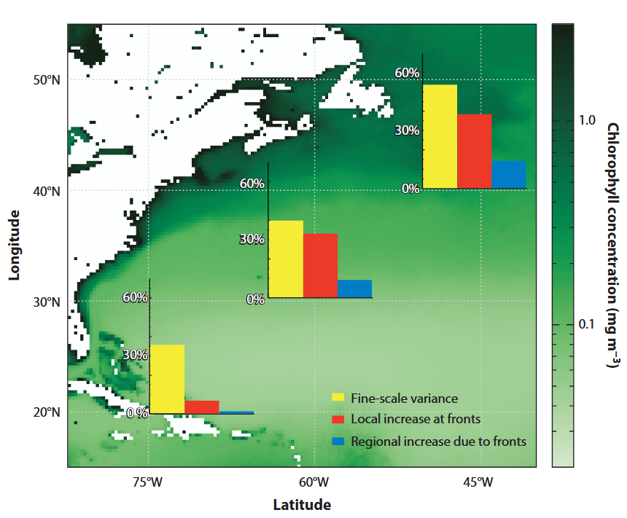
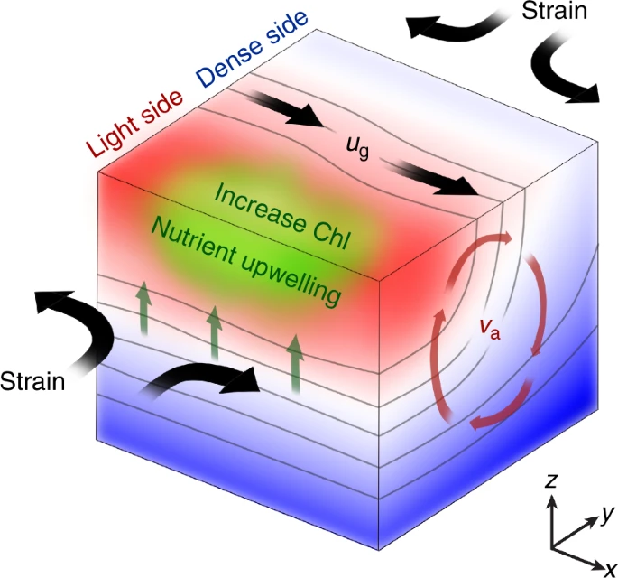
Frontal enhancement of Chl production
Keerthi et al, 2022
Haeck et al. 2023
Zhang et al. 2019
Notes:
Fronts affect phytoplankton growth and phenology by locally reducing stratification and increasing vertical nutrient supply
We found that weak fronts lead to a local enhancement of Chlorophyll-a weaker than strong fronts, but because they are also more frequent they contribute equally to the regional Chlorophyll-a budget. We also find the the local enhancement of Chlorophyll-a was two to three times larger for the spring bloom than in the oligotrophic subtropical gyre. We also provide observational evidence that blooms start earlier over fronts
Meso and submeso scales contribute equally to Chl patches; Lagrangian pathway reconstruction → SWOT has highest resolution ever!
LEFT IMAGE: Slowly evolving balanced ageostrophic component dominates primary production of Chl

Slide 16




Key methodological strenghts and issues
In-situ
Float profilers and buoys
Autonomous operation
Cross-frontal circulations and strong events
X Number of observable events still low
X Rapidly changing conditions
Remote sensing
Numerical models
SWOT has highest spatial res. available!
X Slow rivisit period

